Slide 1
COVID- 19 Data Science Project
Joseph Rochelle
DSC 530 Think Stats Exploratory Data Analysis
8/4/2020

Slide 2
Dataset & Data Cleaning
The dataset is available from New York Times and GitHub: https://github.com/nytimes/covid-19-data/blob/master/live/us-states.csv
The data is clean for cases and deaths but have NAN as some states did not utilize the same procedures for confirmed/probable cases
NaN was used to skip cases where observed

Slide 3
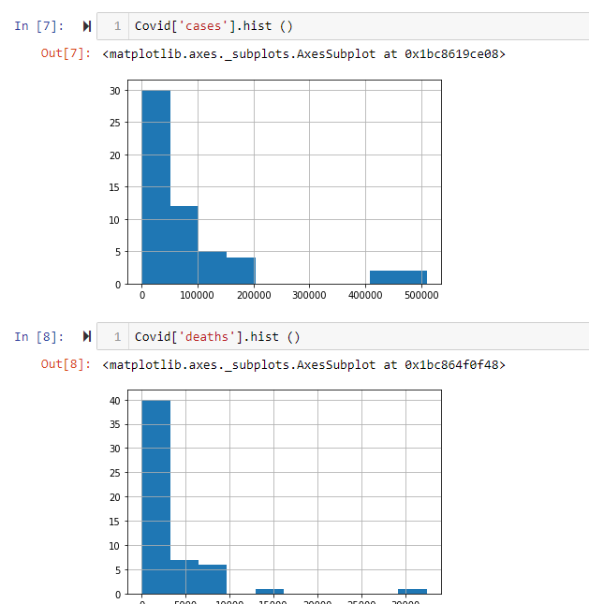
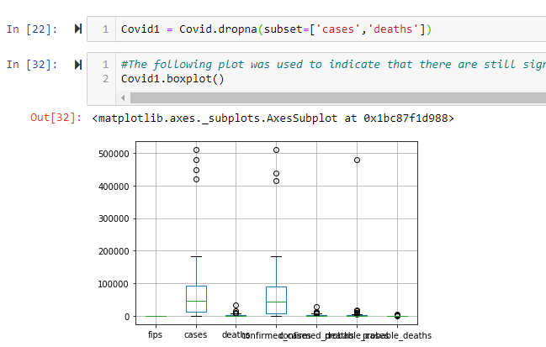
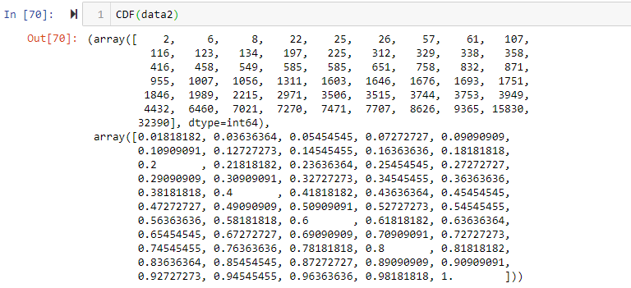
Histograms, Analytical methods, and CDF/PMF
Histograms used to determine data distributions and outliers
Analytical methods/box plot used to see how tails/spread would look and kept for this data
CDF/PMF used to guide where cases fall in distributions and/or probability

Slide 4
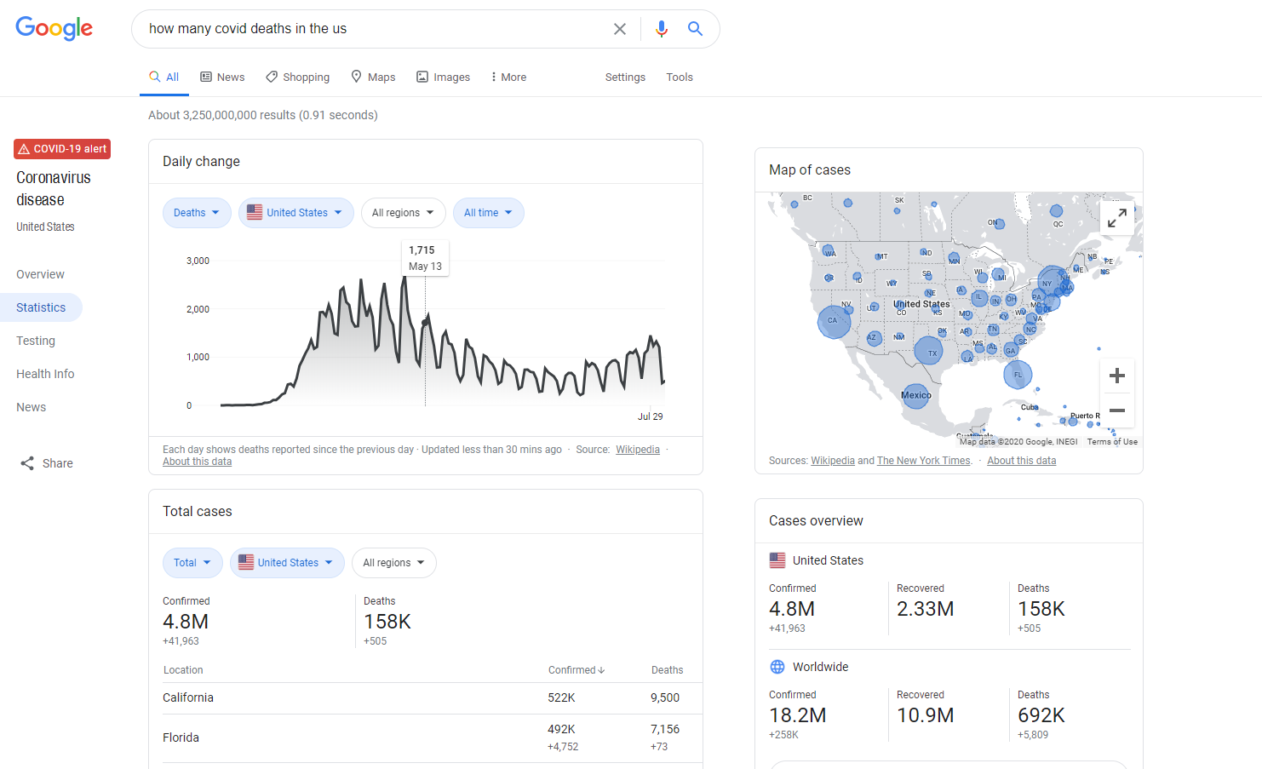
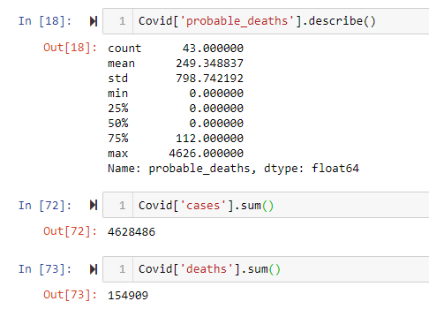
Descriptive Statistics
Statistics matched perfectly for data pulled from GitHub and matched up to another website examining the live data feed within 2 days of each other.
The Users data of 4.6M and 154K cases
Googles data of 4.8M and 158K cases
There were two days off of each other.
Click Here for Live Covid Data

Slide 5
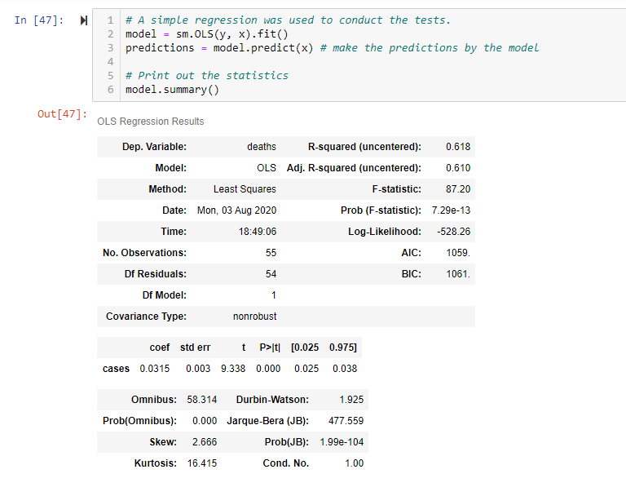
Omnibus Hypothesis Testing
HO: There is not a relationship between cases and deaths
HA: There is a relationship between cases and deaths

Slide 6
Outcomes
Outcome and analysis:
First of all the RSquared value indicates the model only explains 61% of the deaths related to cases. Obviously looking at the data set, we do not have additional constructs to measure as independent variables to the root causes of the deaths other than Covid-19. In other words, what other factors lead to these deaths?
The Durbin-Watson statistic indicates a value of 2.0 out of a 0 to 4 scale which indicates there is no autocorrelation detected. Meaning, results with the p-values will be valid and not diluted by measures that are distributed similarly to the other constructs.
We can see that p= 0.00 is indicating that Covid Cases to Deaths are statistically significant. The Coef of 0.0315 indicates that as cases increase by 1 so will deaths at 0.0315%
We reject the null hypothesis and accept the alternative: There is a relationship between cases and deaths.

